Slide 1
Azure ML - Classification
Citizen Analytics – An Initiative by Data Science Team
S T A R T
Internal

Slide 2
Learning Objectives
By the end of this module, you will be able to:
01
Define classification and how it works
02
Describe different types of classification algorithms
03
Learn how to perform classification in Azure ML Studio
Internal

Slide 3
Content
01.
Classification
What is classification?
Classification modeling
04
05.
Neural Networks
Theory
Hands-on
27
02.
Two-class classification
2-class Logistic Regression
Hands-on
07
06.
Support Vector Machine
Theory
Hands-on
31
03.
Multi-class classification
Multiclass Logistic Regression
Hands-on
15
07.
Summary
35
08.
References
37
04.
Decision Tree
2-class Boosted Decision Tree
Hands-on
2-class Decision Forest
Hands-on
19
Internal

Slide 4
Classification
Internal

Slide 5
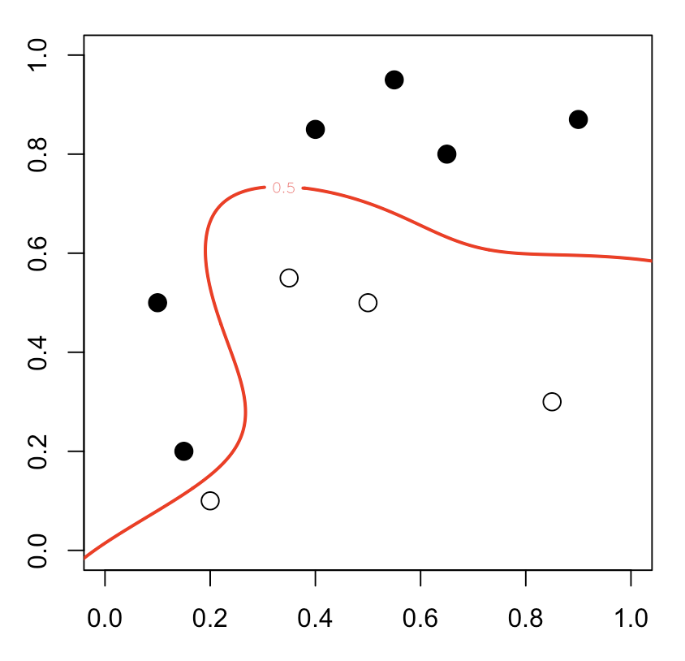
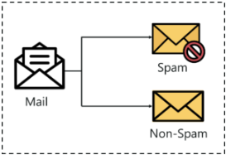
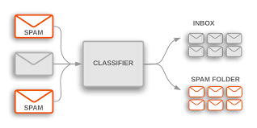
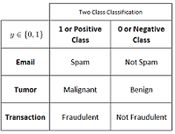


What is classification
Classification is a supervised machine learning method. It is a process of categorizing a given set of data into classes.
It can be performed on both structured or unstructured data.
The process starts with predicting the class of given data points. The classes are often referred to as target, label or categories.
The classification predictive modelling is the task of approximating the mapping function from input variables to discrete output variables.
The main goal is to identify which class/category the new data will fall into.
Classification
$$f\left(x\right)=y$$
Two Class Classification
$$y ∈\{0,1\}$$
1 or Positive Class
0 or Negative Class
Prediction function
Image feature
Output (label)
Email
Spam
Not Spam
Tumor
Malignant
Benign
Transaction
Fradulent
Not Fradulent
Internal

Slide 6
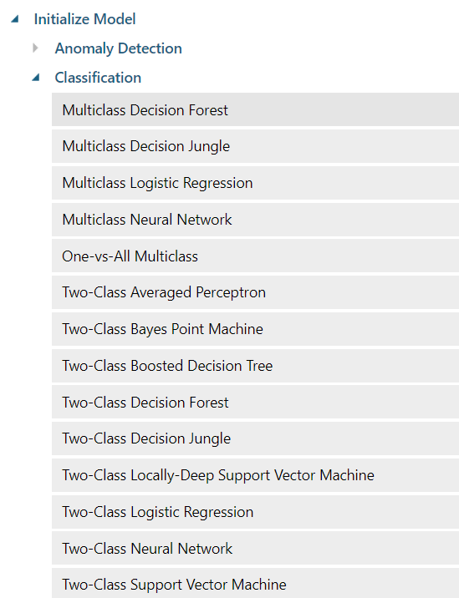
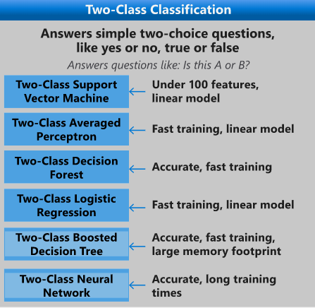
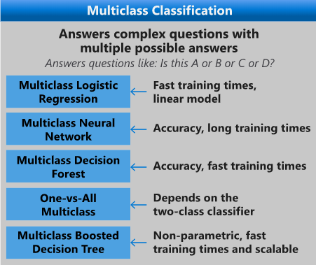
Classification modeling
To create a classification model, or classifier, first, select an appropriate algorithm. Consider these factors:
How many classes or different outcomes do you want to predict?
What is the distribution of the data?
How much time can you allow for training?
Machine Learning Studio (classic) provides multiple classification algorithms.
After choosing the appropriate algorithm, train the model on labelled data.
Evaluate, tune and score the model to get the accuracy of your model.
Classification algorithms
Source: Machine Learning Algorithm Cheat Sheet for Azure Machine Learning designer. https://docs.microsoft.com/en-us/azure/machine-learning/algorithm-cheat-sheet
Internal

Slide 7
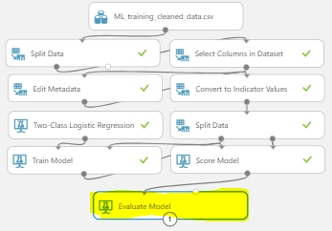
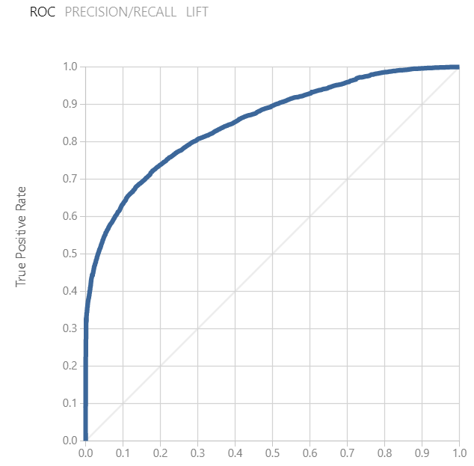
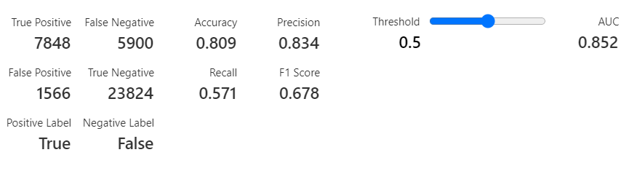
ROC Curve
ROC curve (Receiver-Operator Characteristic) Curve
Area Under Curve gives overall quality of model for getting True Positives.
Plot True Positives vs Threshold for classifying Prediction as Positive.
Threshold=0 – everything is Positive so you’ll get all True Positives.
Threshold=1 – everything is Negative so all will be missed.
Set a threshold -> Determine Positives and Negatives -> Evaluate if TP, TN, FP, FN.
Populate Confusion Matrix
Model Evaluation
Internal

Slide 8

Confusion Matrix and Metrics
$$Accuracy= \frac{TP+TN}{TP+FP+FN+TN}$$
$$Precision=\frac{TP}{TP+FP}$$
$$Recall= \frac{TP}{TP+FN}$$
$$F1 score=\frac{2}{1/{Precision}+1/{Recall}}$$
How often am I correct?
True Positive
False Negative
TRUE
How many Trues were right out my True predictions?
Actual Classes
False Positive
True Negative
How many Trues did I get out of all the Trues?
FALSE
TRUE
FALSE
Better to have better % of predicted Trues in my predictions or out of the Actual Trues??
Predicted Classes
Harmonic Mean
Stronger weight for lower values of either Precision or Recall. Ie 80%,80% is better than 90%,70%.
Think of velocities… average velocity for 50:50 journey at 20mph & 40mph = 26.666mph.
Internal

Slide 9
Getting started with data
Download data ingestion script here:
Try and follow along but I’ll share full workflows with you…
Data ingestion
https://gallery.cortanaintelligence.com/Experiment/CLASSIFICATION-EXPERIMENT-DATA-INGESTION
Internal

Slide 10
Two-class classification (Logistic Regression)
Internal

Slide 11
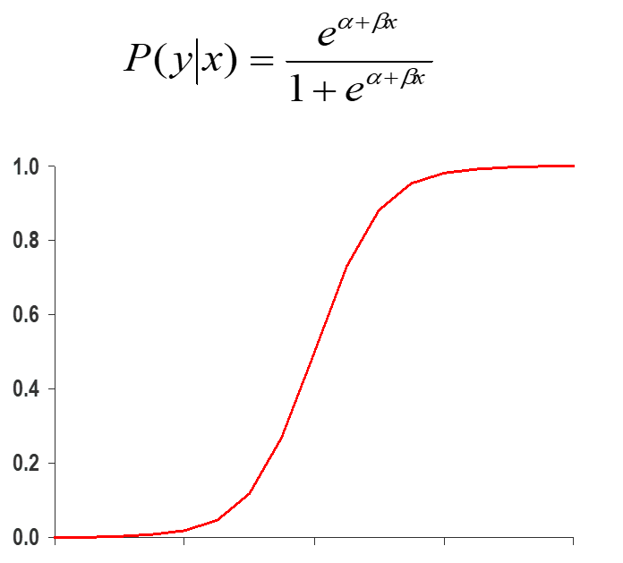
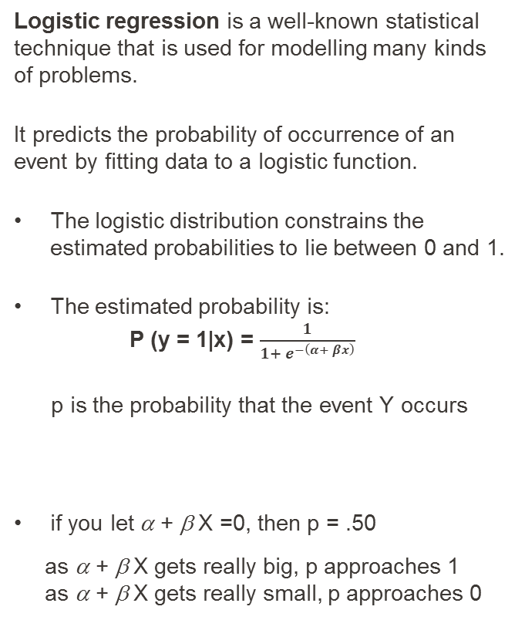
What is Logistic Regression?
Logistic regression is a well-known statistical technique that is used for modelling many kinds of problems.
It predicts the probability of occurrence of an event by fitting data to a logistic function.
The logistic distribution constrains the estimated probabilities to lie between 0 and 1.
The estimated probability is: P (y = 1|x) = $\frac{1}{1+ e^{−\left(α+ βx\right)}}$
p is the probability that the event Y occurs
if you let α + β X =0, then p = .50
as α + β X gets really big, p approaches 1
as α + β X gets really small, p approaches 0
Logistic Regression
Internal

Slide 12
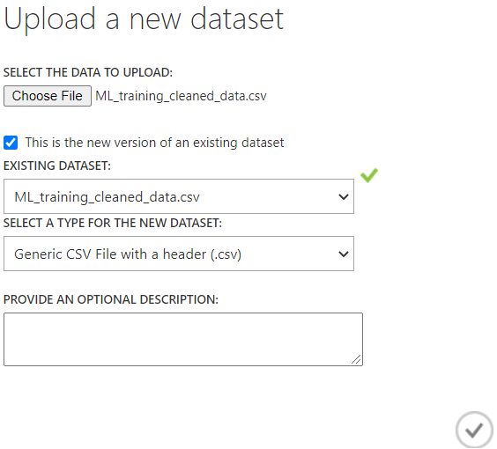
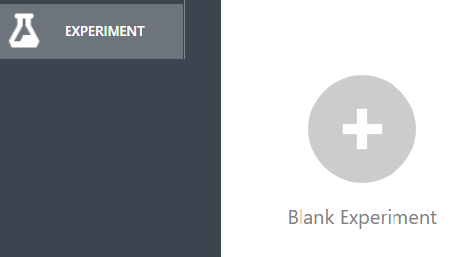
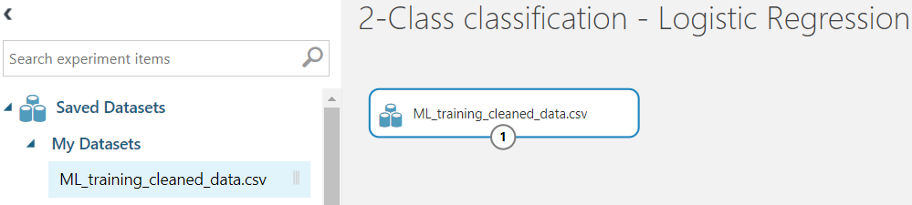
Hands-on: Azure ML Studio: 2-Class Logistic Regression
Use Case: Predict the booking cancelation of hotel booking data
Steps:
Load the data into dataset area
Create an empty experiment
Drag the uploaded dataset
(Cont…)
Logistic Regression - Experiment
Internal

Slide 13
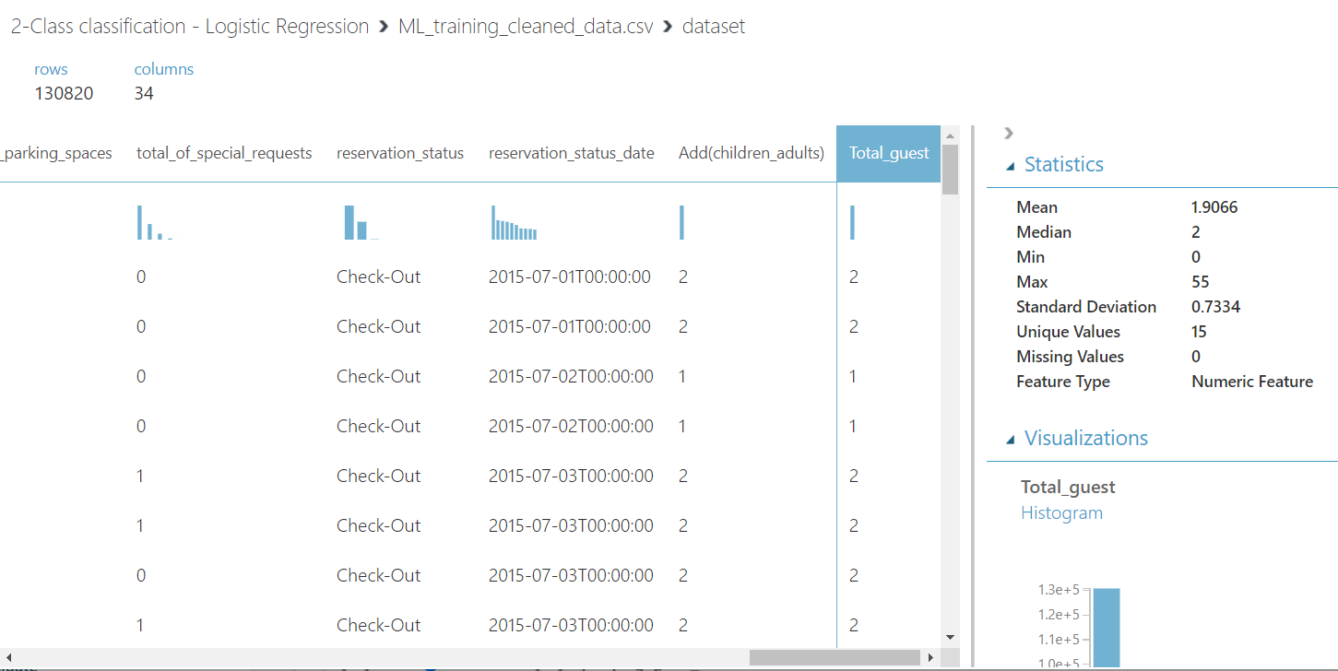
Hands-on: Azure ML Studio: 2-Class Logistic Regression
Use Case: Predict the booking cancelation of hotel booking data
Steps:
Visualize the data
A new modified column named “Total_guest” is already there.
No missing values as already been taken care in previous sections.
All columns are properly categorized for data types.
(Cont..)
Visualize data
Internal

Slide 14
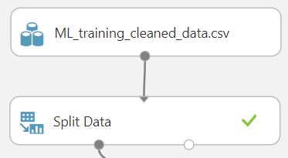
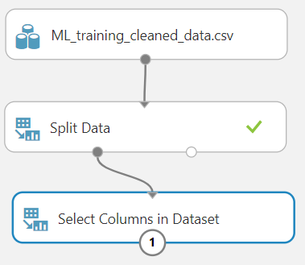
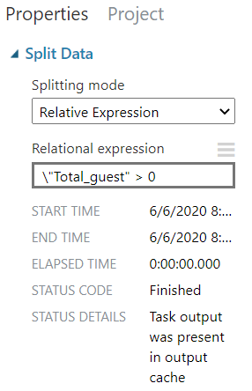
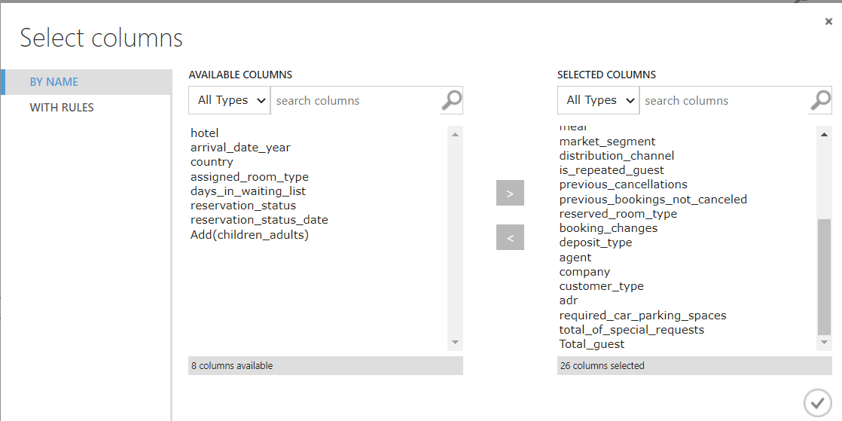
Hands-on: Azure ML Studio: 2-Class Logistic Regression
Use Case: Predict the booking cancelation of hotel booking data
Steps:
Data correction
Add split data in experiment area.
Use the parameters as selected.
Select columns
Select specific columns.
(Cont…)
Data – Filter & Select columns
Internal

Slide 15
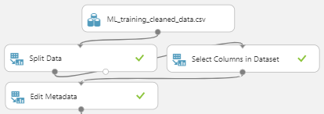
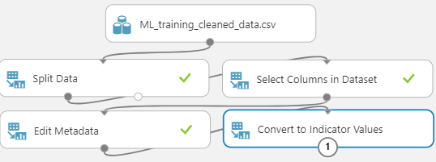
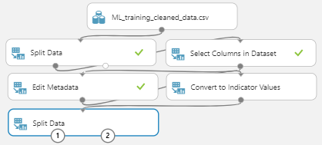
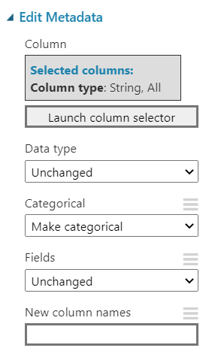
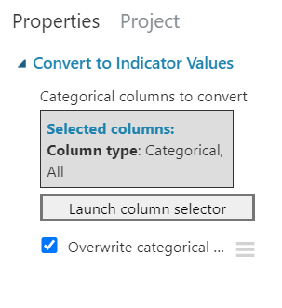
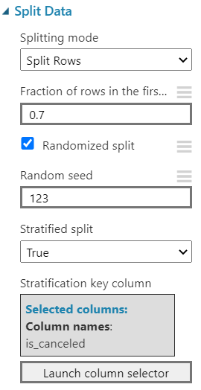
Hands-on: Azure ML Studio: 2-Class Logistic Regression
Use Case: Predict the booking cancelation of hotel booking data
Steps:
Edit Metadata
Drag “Edit Metadata”.
Use the parameters as selected.
Convert to Indicator values
Drag “Convert to Indicator Values”.
Choose the parameters as shown.
Split data for model development
Drag “Split Data”.
Choose the parameters as shown.
(Cont…)
Categorical and Indicator variables
Categoricals -> Each class own column with 1 or 0
Internal

Slide 16
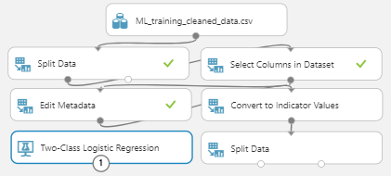
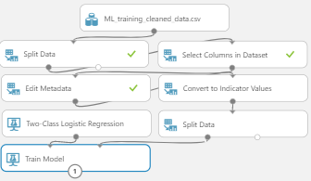
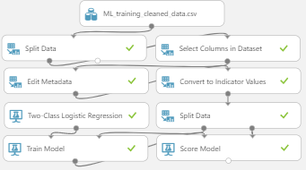
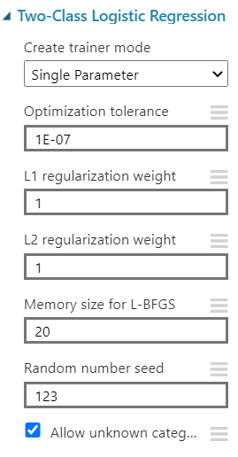
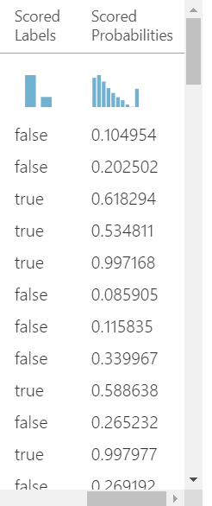
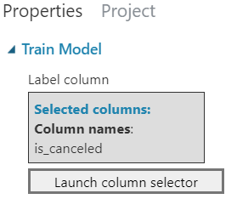
Hands-on: Azure ML Studio: 2-Class Logistic Regression
Use Case: Predict the booking cancelation of hotel booking data
Steps:
Two-class logistic regression
Drag “Two-Class Logistic Regression”.
Choose the parameters as shown.
Train Model
Drag “Train Model”.
Choose the parameters as shown.
Score Model
Drag “Score Model”.
Choose the parameters as shown.
(Cont…)
Model Development
Internal

Slide 17
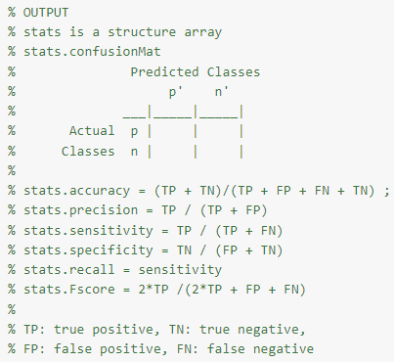
Hands-on: Azure ML Studio: 2-Class Logistic Regression
Use Case: Predict the booking cancelation of hotel booking data
Steps:
Evaluate Model
Drag “Evaluate Model”.
Evaluate the output
Understand the ROC curve.
Understand the
AUC
Confusion Matrix
Model Evaluation
Internal

Slide 18
Multi-class classification (Logistic Regression)
Internal

Slide 19
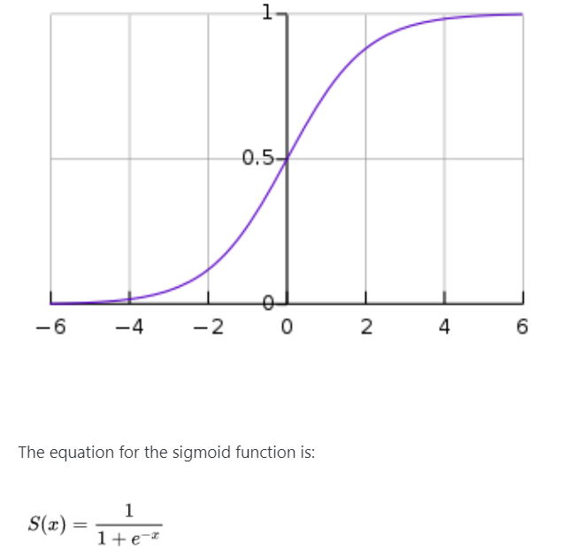
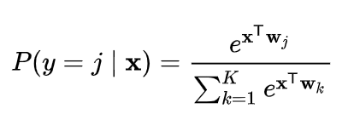
What is Multi-Class Logistic Regression?
Multi-class logistic regression is a modelling algorithm that can be used to predict multiple values.
In its vanilla form logistic regression is used to do binary classification.
Multiclass classification with logistic regression can be done either through
the one-vs-rest scheme in which for each class a binary classification problem of data belonging or not to that class is done,
or changing the loss function to cross- entropy loss.
Logistic Regression
Internal

Slide 20
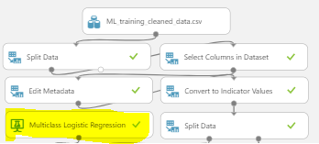
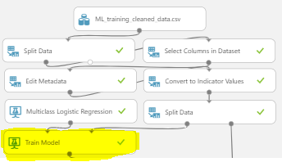
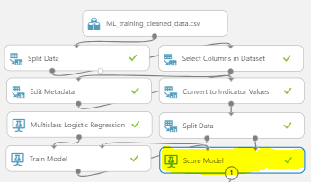
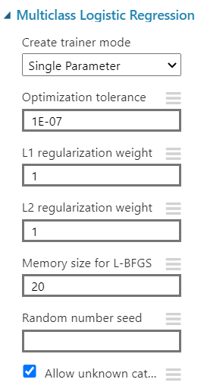
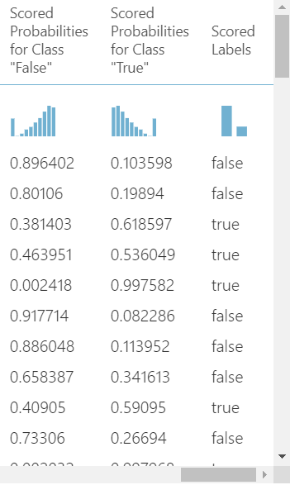
Hands-on: Azure ML Studio: Multi-Class Logistic Regression
Use Case: Predict the booking cancelation of hotel booking data. Though multi-class isn’t suitable in this use case but shown just for depiction purpose only.
Steps:
Follow Steps 1 to 9 mentioned in slides 9 to 12.
Multi-class logistic regression
Drag “Multi-Class Logistic Regression”.
Choose the parameters as shown.
Train Model
Drag “Train Model”.
Choose the parameters as shown.
Score Model
Drag “Score Model”.
Choose the parameters as shown.
(Cont…)
Model Development
Internal

Slide 21
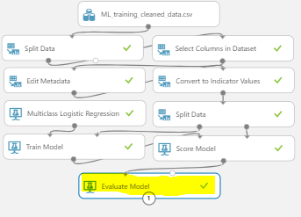
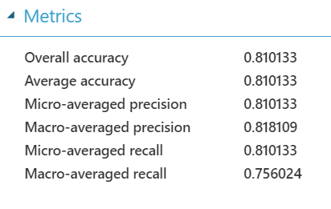
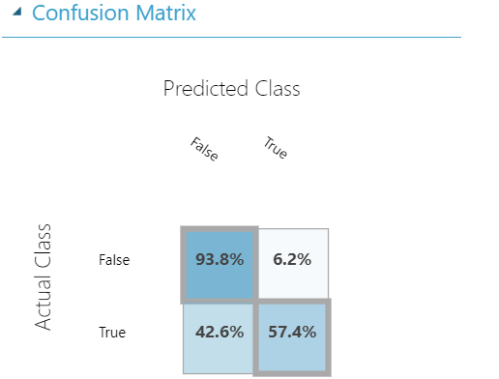
Hands-on: Azure ML Studio: Multi-Class Logistic Regression
Use Case: Predict the booking cancelation of hotel booking data
Steps:
Evaluate Model
Drag “Evaluate Model”.
Evaluate the output
Understand the Metrics.
Confusion Matrix
(Cont…)
Model Evaluation
Internal

Slide 22
Decision Tree
Internal

Slide 23
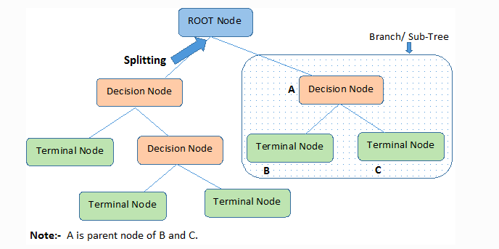
What is Decision Tree?
Decision tree is a supervised learning method.
This uses a tree like graph or model of decisions and their possible consequences.
Various variations are available such as:
Boosted Decision Tree
Decision Forest
Decision Jungle
Can be used for categorical as well as continuous variables.
Key Terms:
Root Node: Entire population or sample
Splitting: Process of diving a node into sub-nodes
Decision Node: Sub-node splits into further sub-nodes
Leaf / Terminal Node: Nodes do not split
Branch / Sub-Tree: Sub section of entire tree
Decision Tree
Source: Decision Tree Algorithm, Explained. https://www.kdnuggets.com/2020/01/decision-tree-algorithm-explained.html
Internal

Slide 24
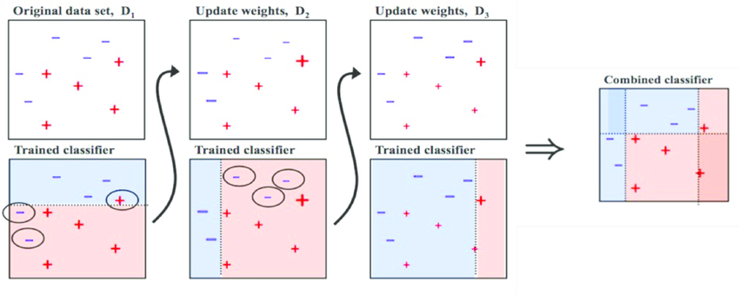
What is 2-Class Boosted Decision Tree?
Boosting
Implies to train the Decision Tree in a sequence.
Learn from the previous tree by focusing on incorrect observations.
Build new model with higher weight for incorrect observations from previous sequence.
Two-Class Boosted Decision Tree
It is based on boosted decision tree algorithm.
It is an ensemble learning method.
Among the easiest method to get top performance.
One of the more memory intensive learners.
Boosted Decision Tree
Source: Understanding AdaBoost for Decision Tree. https://towardsdatascience.com/understanding-adaboost-for-decision-tree-ff8f07d2851
Internal

Slide 25
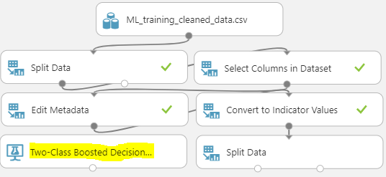
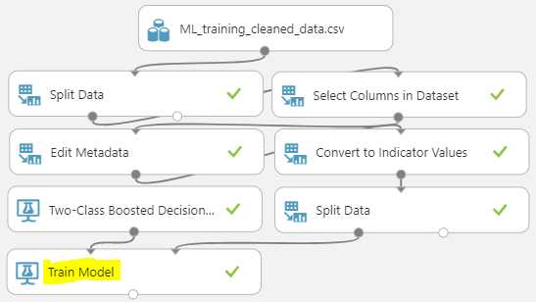
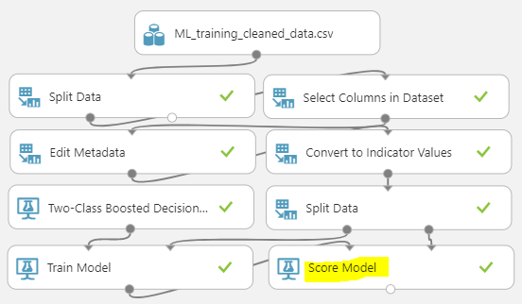
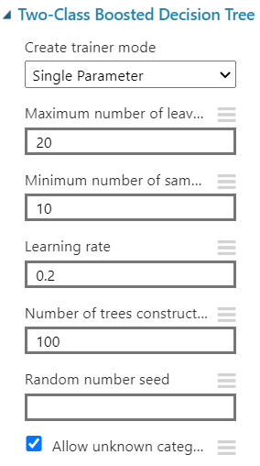

Hands-on: Azure ML Studio: 2-Class Boosted Decision Tree
Use Case: Predict the booking cancelation of hotel booking data
Steps:
Follow Steps 1 to 9 mentioned in slides 9 to 12.
Two-Class Boosted Decision Tree
Drag “Two-Class Boosted Decision Tree”.
Choose the parameters as shown.
Train Model
Drag “Train Model”.
Choose the parameters as shown.
Score Model
Drag “Score Model”.
Choose the parameters as shown.
(Cont…)
Model Development
Internal

Slide 26



Hands-on: Azure ML Studio: 2-Class Boosted Decision Tree
Use Case: Predict the booking cancelation of hotel booking data
Steps:
Evaluate Model
Drag “Evaluate Model”.
Evaluate the output
Understand the ROC curve.
Understand the
AUC
Confusion Matrix
(Cont…)
Model Evaluation
Internal

Slide 27


What is 2-Class Decision Forest Tree?
Bagging
Various models are built in parallel.
All models vote to predict the final prediction.
Many individual classification trees are created, using the entire dataset, but different (usually randomized) starting points.
Two-Class Decision Forest Tree
It is based on bagging decision tree algorithm.
It is an ensemble learning method.
Building multiple decision trees and then voting on the most popular output class.
Trees can accommodate noisy data and many features.
Decision Forest
Source: Random Forest Classifier in Layman Terms. http://storybydata.com/datacated-challenge/random-forest-classifier-in-layman-terms/
Internal

Slide 28





Hands-on: Azure ML Studio: 2-Class Decision Forest
Use Case: Predict the booking cancelation of hotel booking data
Steps:
Follow Steps 1 to 9 mentioned in slides 9 to 12.
Two-Class Decision Forest
Drag “Two-Class Decision Forest”.
Choose the parameters as shown.
Train Model
Drag “Train Model”.
Choose the parameters as shown.
Score Model
Drag “Score Model”.
Choose the parameters as shown.
(Cont…)
Model Development
Internal

Slide 29



Hands-on: Azure ML Studio: 2-Class Decision Forest
Use Case: Predict the booking cancelation of hotel booking data
Steps:
Evaluate Model
Drag “Evaluate Model”.
Evaluate the output
Understand the ROC curve.
Understand the
AUC
Confusion Matrix
(Cont…)
Model Evaluation
Internal

Slide 30
Neural Network
Internal

Slide 31

What is Neural Network?
Neural Network
A neural network is a set of interconnected layers.
The inputs are the first layer, and are connected to an output layer by an acyclic graph comprised of weighted edges and nodes.
Between the input and output layers you can insert multiple hidden layers.
All nodes in a layer are connected by the weighted edges to nodes in the next layer.
An activation function is then applied to that weighted sum.
Most predictive tasks can be accomplished easily with only one or a few hidden layers.
Neural Network
Source: Using deep learning to investigate the neuroimaging correlates of psychiatric and neurological disorders: Methods and applications. https://www.researchgate.net/publication/312205163_Using_deep_learning_to_investigate_the_neuroimaging_correlates_of_psychiatric_and_neurological_disorders_Methods_and_applications
Internal

Slide 32





Hands-on: Azure ML Studio: 2-Class Neural Network
Use Case: Predict the booking cancelation of hotel booking data.
Steps:
Follow Steps 1 to 9 mentioned in slides 9 to 12.
Two-Class Neural Network
Drag “Two-Class Neural Network”.
Choose the parameters as shown.
Train Model
Drag “Train Model”.
Choose the parameters as shown.
Score Model
Drag “Score Model”.
Choose the parameters as shown.
(Cont…)
Model Development
Internal

Slide 33



Hands-on: Azure ML Studio: 2-Class Neural Network
Use Case: Predict the booking cancelation of hotel booking data
Steps:
Evaluate Model
Drag “Evaluate Model”.
Evaluate the output
Understand the ROC curve.
Understand the
AUC
Confusion Matrix
(Cont…)
Model Evaluation
Internal

Slide 34
Support Vector Machine
Internal

Slide 35

What is Support Vector Machine?
Support Vector Machine
Support vector machines are among the earliest of machine learning algorithms.
SVMs can be used for both classification and regression tasks.
The algorithm analyzes input data and recognizes patterns in a multi-dimensional feature space called the hyperplane.
All input examples are represented as points in this space, and are mapped to output categories in such a way that categories are divided by as wide and clear a gap as possible.
For prediction, the SVM algorithm assigns new examples into one category or the other, mapping them into that same space.
Support Vector Machine
Source: Support Vector Machine Algorithm. https://www.javatpoint.com/machine-learning-support-vector-machine-algorithm
Internal

Slide 36





Hands-on: Azure ML Studio: 2-Class Support Vector Machine
Use Case: Predict the booking cancelation of hotel booking data.
Steps:
Follow Steps 1 to 9 mentioned in slides 9 to 12.
Two-Class Support Vector Machine
Drag “Two-Class Support Vector Machine”.
Choose the parameters as shown.
Train Model
Drag “Train Model”.
Choose the parameters as shown.
Score Model
Drag “Score Model”.
Choose the parameters as shown.
(Cont…)
Model Development
Internal

Slide 37



Hands-on: Azure ML Studio: 2-Class Support Vector Machine
Use Case: Predict the booking cancelation of hotel booking data
Steps:
Evaluate Model
Drag “Evaluate Model”.
Evaluate the output
Understand the ROC curve.
Understand the
AUC
Confusion Matrix
(Cont…)
Model Evaluation
Internal

Slide 38
Summary
Internal

Slide 39



Summary
What is classification?
Classification is a supervised machine learning method that categorizes a given set of data into multiple classes
Different classification algorithms available in Azure ML Studio
2-class logistic regression, multiclass logistic regression, 2-class boosted decision tree, 2-class neural network, 2-class support vector machine etc.
Basic workflow for classification
Data treatment, choose the appropriate algorithm, train and tune the model, evaluate the scores
Internal

Slide 40
References
Internal

Slide 41
References
Classification in Azure ML
https://docs.microsoft.com/en-us/azure/machine-learning/studio-module-reference/machine-learning-initialize-model-classification
2-class Logistic Regression
https://docs.microsoft.com/en-us/azure/machine-learning/studio-module-reference/two-class-logistic-regression
Multiclass Logistic Regression
https://docs.microsoft.com/en-us/azure/machine-learning/studio-module-reference/multiclass-logistic-regression
2-class Boosted Decision Tree
https://docs.microsoft.com/en-us/azure/machine-learning/studio-module-reference/two-class-boosted-decision-tree
2-class Decision Forest
https://docs.microsoft.com/en-us/azure/machine-learning/studio-module-reference/two-class-decision-forest
2-class Neural Network
https://docs.microsoft.com/en-us/azure/machine-learning/studio-module-reference/two-class-neural-network
https://docs.microsoft.com/en-us/azure/machine-learning/studio-module-reference/two-class-support-vector-machine
2-class Support Vector Machine
Model Answers
https://gallery.cortanaintelligence.com/Experiment/CLASSIFICATION-EXPERIMENT-2
Internal

Slide 42
References
Azure ML Cheat Sheet
https://docs.microsoft.com/en-us/azure/machine-learning/algorithm-cheat-sheet
Decision Tree Algorithm
https://www.kdnuggets.com/2020/01/decision-tree-algorithm-explained.html
AdaBoost Decision Tree
https://towardsdatascience.com/understanding-adaboost-for-decision-tree-ff8f07d2851
Random Forest Classifier
http://storybydata.com/datacated-challenge/random-forest-classifier-in-layman-terms/
https://www.researchgate.net/publication/312205163_Using_deep_learning_to_investigate_the_neuroimaging_correlates_of_psychiatric_and_neurological_disorders_Methods_and_applications
Neural Networks
Support Vector Machine
https://www.javatpoint.com/machine-learning-support-vector-machine-algorithm
Internal

Slide 43
Thank you for your passion!
Internal

